Slide 1
MIS 753: Assignment 2 Superstore Data : Profit Leak Analysis
Presented By:
Brandon Ledesma, Marco Nunez, Bhagyashri Patil

Slide 2
What Exactly is Profit Leak?
Profit leak is defined by the loss of profit due to the difference between price and invoice
If we analyze profit leak, we can reduce the overall net loss of a company’s operations/sales
We have analyzed the Superstore dataset for profit leakage and came with some insights on the various dimensions, that when added together accumulate to a final profit leak of $77,068.38
Profit leak can be better explained by the following slides involving this dataset’s top 3 contributors of profit leak

Slide 3
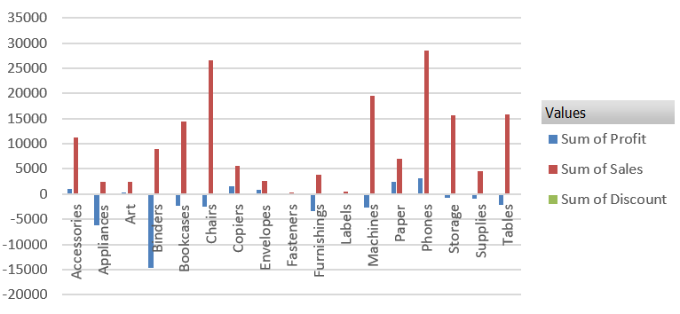
Texas
Highest Total leak of $36,810.12
Main product issues
No profit on binders, appliances, furnishings, machines, chairs, bookcases, and tables

Slide 4
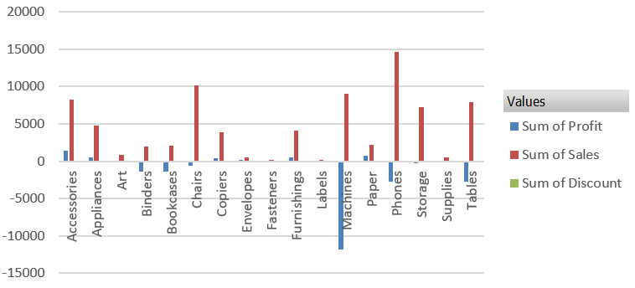
Ohio
Second Highest - Total leak of $21,747.553
Main product issues
No profit on tables, phones (some accessories are profitable), machines, chairs, bookcases, and binders
Most shelving in storage sold at a loss

Slide 5
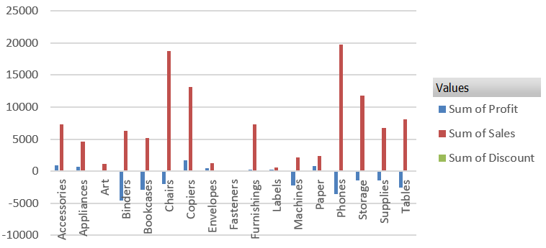
Pennsylvania
Third Highest - Total leak of $21,602.85
Main product issues
No profit on binders, phones, bookcases, tables, machines, chairs, and supplies

Slide 6
Profit Leak by Sub-Category
Row Labels | Sum of Profit
Tables | -17725.4811
Bookcases | -3472.556
Supplies | -1189.0995
Fasteners | 949.5182
Machines | 3384.7569
Labels | 5546.254
Art | 6527.787
Envelopes | 6964.1767
Furnishings | 13059.1436
Appliances | 18138.0054
Storage | 21278.8264
Chairs | 26590.1663
Binders | 30221.7633
Paper | 34053.5693
Accessories | 41936.6357
Phones | 44515.7306
Copiers | 55617.8249
Grand Total | 286397.0217
Florida | Profit
Tables | -2493.1111
Supplies | -197.6315
Bookcases | -116.0706
All categories were profitable, so we will examine sub-categories
We see that tables, bookcases, and supplies are unprofitable
It’s possible that high shipping costs are the cause of this as these products are heavy items
In addition, note that Florida is unprofitable in all three
There may be another cause, but without more data it is difficult to determine

Slide 7
Deeper Dive Into Unprofitable Subcategories
Product | Sum of Profit
Chromcraft Bull-Nose Wood Oval Conference Tables & Bases | -2876.1156
Bush Advantage Collection Racetrack Conference Table | -1934.3976
Martin Yale Chadless Opener Electric Letter Opener | -1299.1836
Balt Solid Wood Round Tables | -1201.0581
BoxOffice By Design Rectangular and Half-Moon Meeting Room Tables | -1148.4375
Riverside Furniture Oval Coffee Table, Oval End Table, End Table with Drawer | -1147.4
O'Sullivan 4-Shelf Bookcase in Odessa Pine | -975.0988
Bretford “Just In Time” Height-Adjustable Multi-Task Work Tables | -964.194
Bevis Oval Conference Table, Walnut | -856.0144
BPI Conference Tables | -795.9725
O'Sullivan Plantations 2-Door Library in Landvery Oak | -767.7436
O'Sullivan Living Dimensions 5-Shelf Bookcases | -755.7516
Hon 94000 Series Round Tables | -681.214
Riverside Palais Royal Lawyers Bookcase, Royale Cherry Finish | -669.5448
Bestar Classic Bookcase | -612.9387
Chromcraft Bull-Nose Wood 48" x 96" Rectangular Conference Tables | -611.5878
Hon Racetrack Conference Tables | -598.5228
Bevis Rectangular Conference Tables | -586.8396
Bretford CR4500 Series Slim Rectangular Table | -532.7613
Bevis Round Conference Table Top, X-Base | -519.941
KI Conference Tables | -479.2164
Bevis Traditional Conference Table Top, Plinth Base | -456.7032
Chromcraft Rectangular Conference Tables | -450.243
Bevis Boat-Shaped Conference Table | -445.587
Premier Automatic Letter Opener | -427.8586
Sauder Forest Hills Library with Doors, Woodland Oak Finish | -418.548
When observing the products filtered by these three underperforming categories, bookshelves and tables make up the bulk of the losses
The few supply-type products that appear higher on the list are letter openers
Without more data we cannot analyze why specific tables and bookshelves are performing poorly, so we will examine the supplies category in more detail

Slide 8
Analysis of Supplies Categories
Product | Profit | Quantity
Martin Yale Chadless Opener Electric Letter Opener | -1299.1836 | 22
Premier Automatic Letter Opener | -427.8586 | 14
High Speed Automatic Electric Letter Opener | -262.0048 | 11
Compact Automatic Electric Letter Opener | -57.2688 | 26
Stiletto Hand Letter Openers | -21.984 | 17
Martin-Yale Premier Letter Opener | -12.88 | 20
Acco Side-Punched Conventional Columnar Pads | -7.8075 | 15
Serrated Blade or Curved Handle Hand Letter Openers | -4.1134 | 9
Acme Rosewood Handle Letter Opener | -3.4936 | 12
Acme Serrated Blade Letter Opener | -1.749 | 5
Premier Electric Letter Opener | -1.91847E-13 | 24
Letter Slitter | 0.3024 | 4
Looking at the supplies category more closely, we see that letter openers make up the bulk of the unprofitable items in this category. We don’t have pricing data, but these are likely small dollar value items. Perhaps they are sold at a loss to drive sales of the larger more profitable items
Cutting the top four offenders may be a smart choice as you can still offer the same product mix with the more profitable items. Note though that two of the three best selling letter openers are in the top four least profitable group. Seeing as that whole type of product is unprofitable a word with the supplier might be in order as well

Slide 9
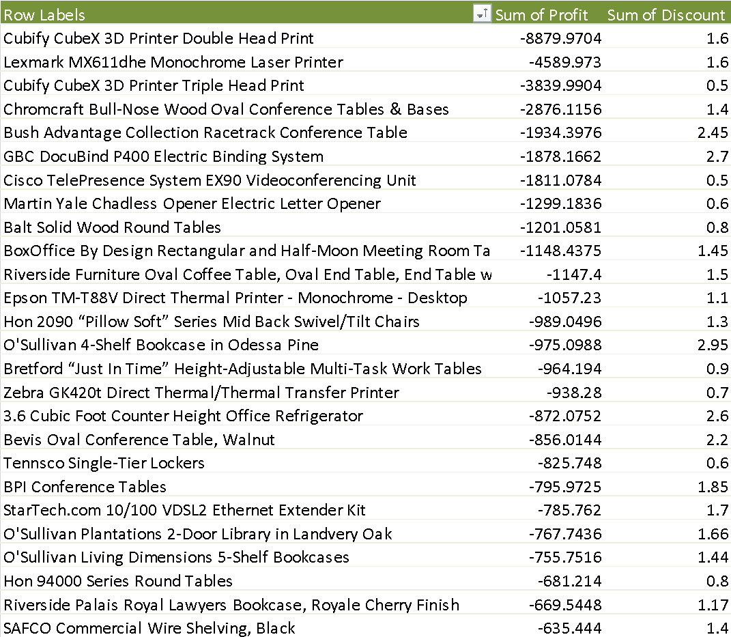
Profit Leaks by Overall Profits
We see here in this table of highest profit leaking products that printers are our biggest culprits. Printers are known to sell at a loss with the goal of selling ink at a high markup later. It’s unclear how that benefits this retailer. Perhaps it’s a condition of their selling of the ink
These and a few other items high on the list come from the machine subcategory. This suggests that that subcategory could potentially be much more profitable. It’s also interesting to note that the discounts on these aren’t extraordinarily high suggesting that that is not the main cause of the profit leakage

Slide 10
Insights and Recommendations
Particular products should not be sold in certain zip codes and the shipping selection should be limited in certain zip codes
Seasonality, city location, buyers, and ship date (whether transportation was more expensive that month) did not seem to have correlation to the profit leaks
Tables, bookshelves, and supplies were negative categories, which suggests that there is an issue with the products themselves. In addition, letter openers in particular were an issue
Solutions to these profit leaks issues are unclear as additional data is needed from the retailer, such as competitor and product trends for states, in order to understand why the products are unprofitable

